Slide 1
DNS
Presented by:
Bijali Jayalakshmi Jayan
S2 MSc CS

Slide 2
CONTENTS
Introduction
Name Space
Domain Name Space
Distribution of name space
DNS in the internet
Resolution
Types of resolution
DDNS
Conclusion

Slide 3
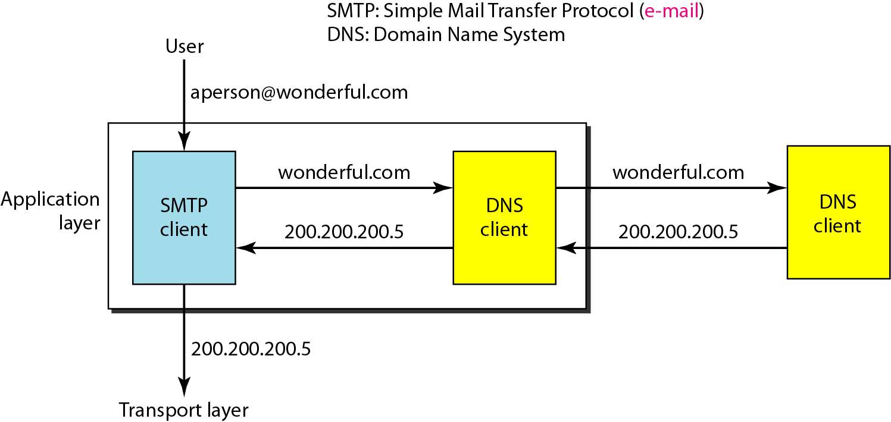
INTRODUCTION
Client-Server Programs
The client/server programs can be divided into two categories: Those that can be directly used by the user, such as e-mail, and those that support other application programs. The Domain Name System (DNS) is a supporting program that is used by other programs such as e-mail.

Slide 4
When the Internet was small, mapping was done by using hosts.txt file.
(Host names are structured character string)
The host file was located at host's disk and updated periodically from a master host file.
When any program or any user wanted to map domain name to an address, the host consulted the host file and found the mapping.
Now Internet is not small, it is impossible to have only one host file to relate every address with a name and vice versa.
The solution used today is to divide the host file into smaller parts and store each part on a different computer.
In this method, the host that needs mapping can call the closest computer holding the needed information.
This method is used in Domain Name System (DNS).

Slide 5
Name space
The names must be unique because the addresses are unique. A namespace that maps each address to a unique name can be organized in two ways: flat or hierarchical. In a flat name space, a name is assigned to an address. A name in this space is ii sequence of characters without structure. The names may or may not have a common section: if they do, it has no meaning. The main disadvantage of a flat name space is that it cannot be used in a large system such as the Internet because it must be central controlled to avoid ambiguity and duplication. In a hierarchical name space, each name is made of several parts. The first part can define the nature of the organization, the second part can define the name of an organization, the third part can define departments in the organization, and so on. The authority to assign and control the name spaces can be decentralized. A central authority can assign the part of the name that defines the nature of the organization and the name of the organization. The responsibility of the rest of the name can be given to the organization itself. The organization can add suffixes (or prefixes).

Slide 6
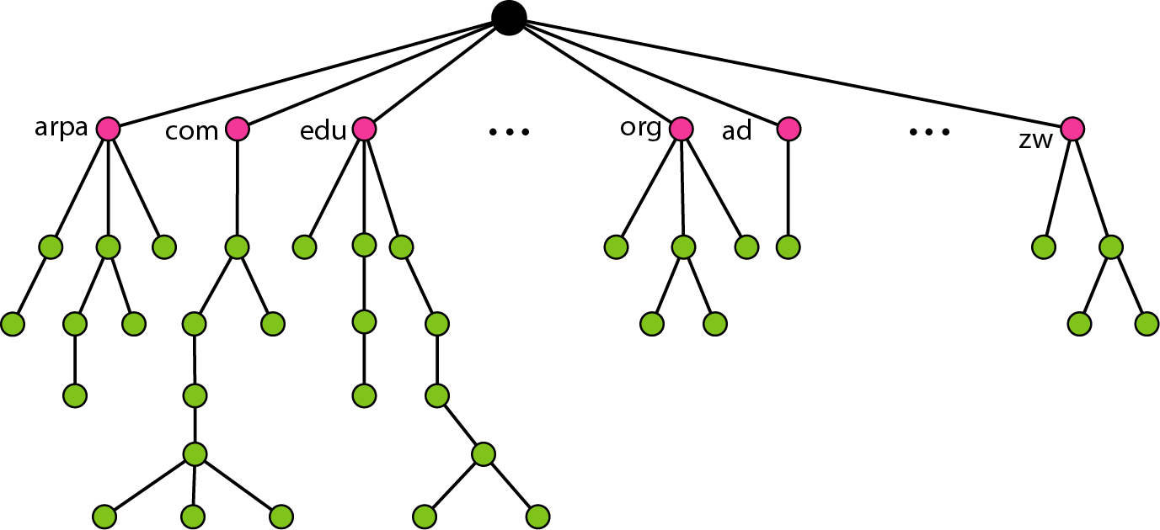
Domain name space
To have a hierarchical name space, a domain name space was designed. In this design the names are denned in an inverted-tree structure with the root at the top. The tree can have only 128 levels: level 0 (root) to level 127.
Label
Each node in the tree has a label, which is a string with a maximum of 63 characters. The root label is a null string (empty string). DNS requires that children of a node (nodes that branch from the same node) have different labels, which guarantees the uniqueness of the domain names.

Slide 7
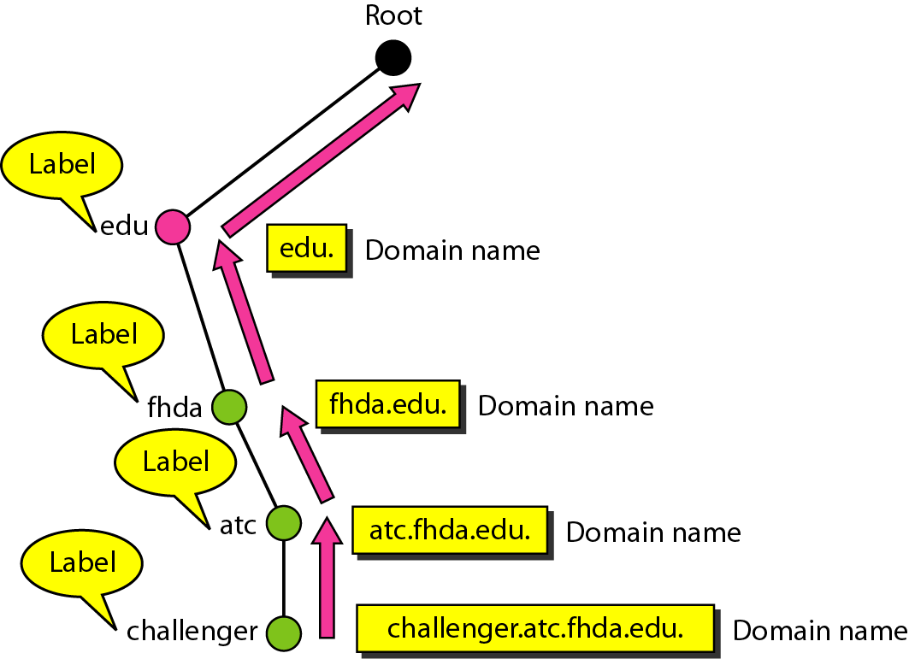

Domain Name
Each node in the tree has a domain name. A full domain name is a sequence of labels separated by dots (.). The domain names are always read from the node up to the root. The last label is the label of the root (null). This means that a full domain name always ends in a null label, which means the last character is a dot because the null string is nothing.
Fully Qualified Domain Name: If the label is terminated by a null string, it is called a fully qualified domain (FQDN). An FQDN is a domain name that contains the full name of a host.
Partially Qualified Domain Name: the label is not terminated by a label. PDQN start from a node but it does not reach the root. It is used when the name to be resolved belongs to the same site as the client.

Slide 8
e.g:) domain name:
www.mgu.ac.in.
Where ‘in’ is TLD or primary domain name.
‘ac’ is subdomain.
It is fqdn
www.mgu.ac.in is pqdn

Slide 9
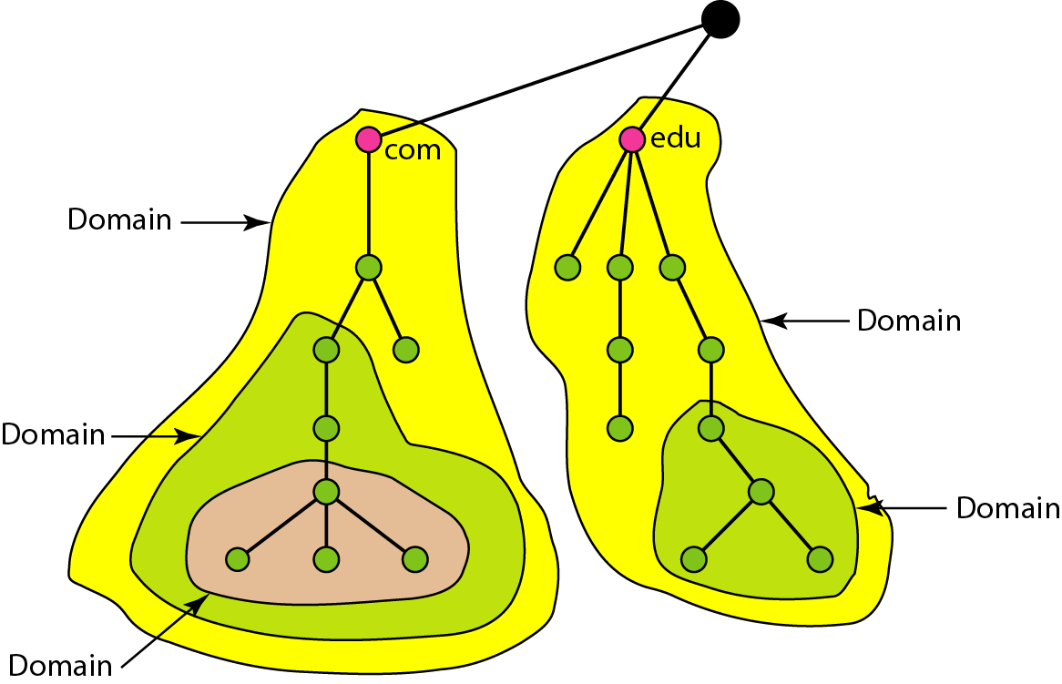
Domain
A domain is a subtree of the domain name space. The name of the domain is the domain name of the node at the top of the subtree. A domain may itself be divided into domains(or subdomains).

Slide 10
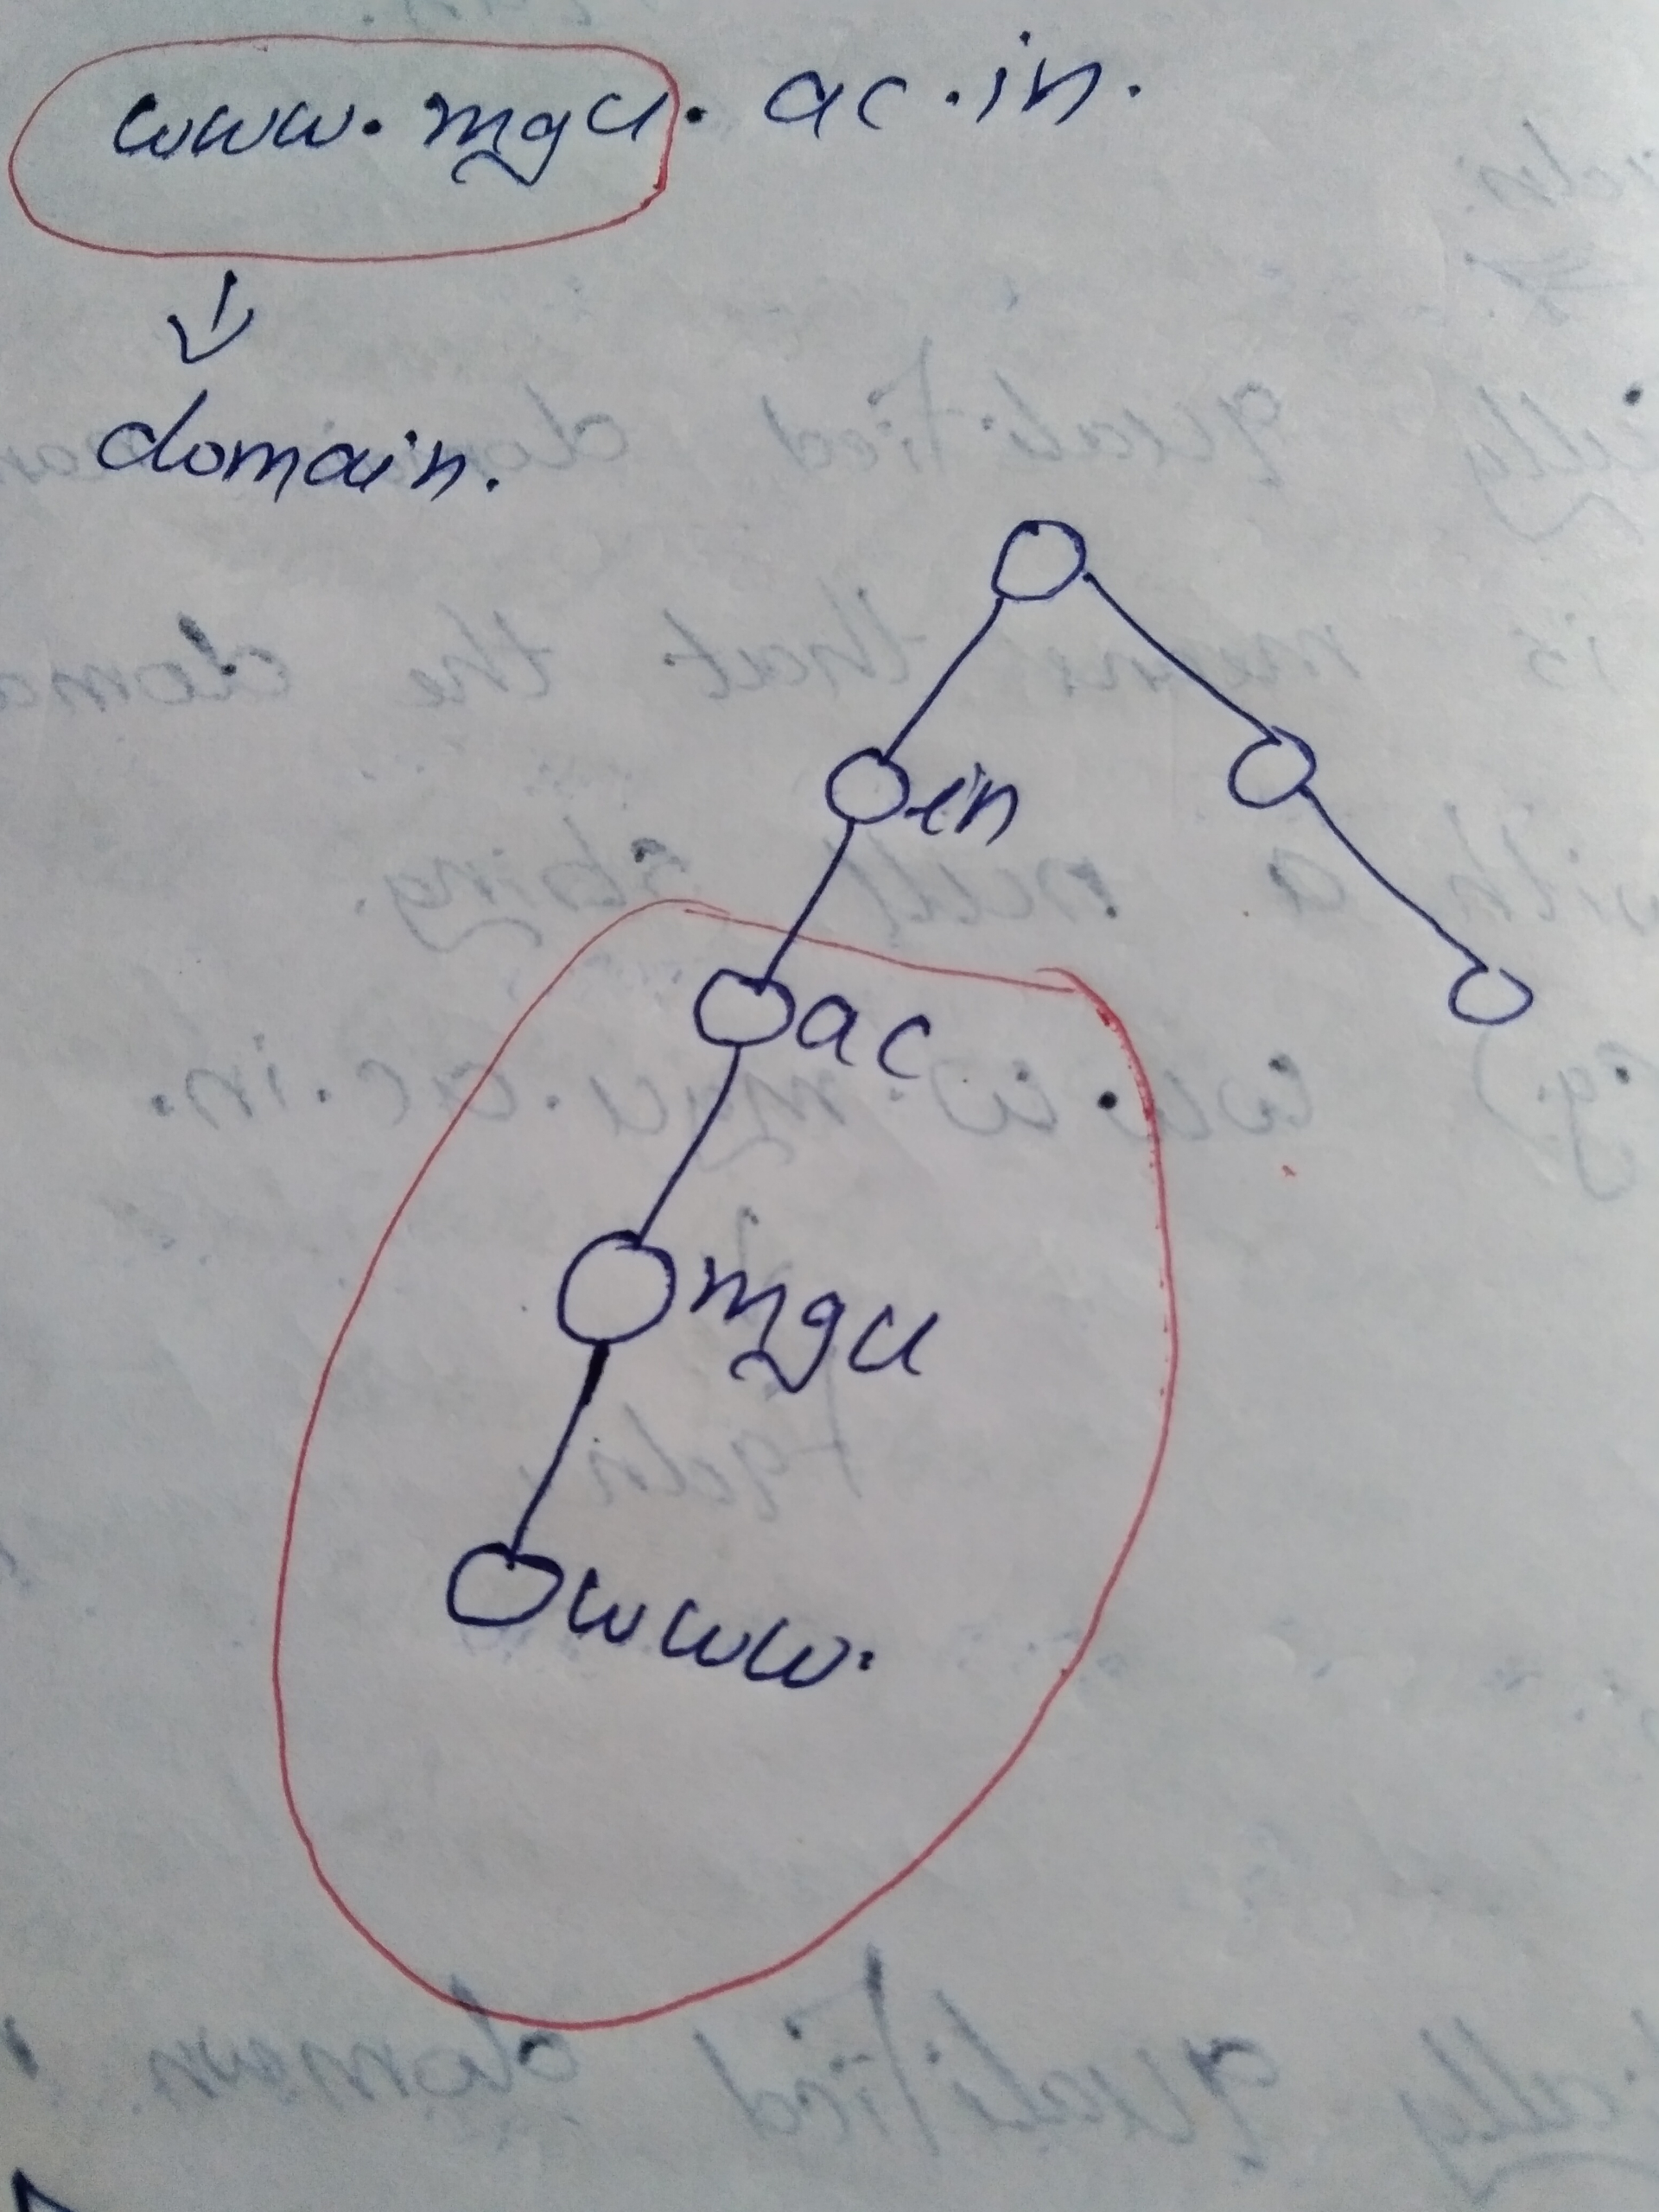

Slide 11
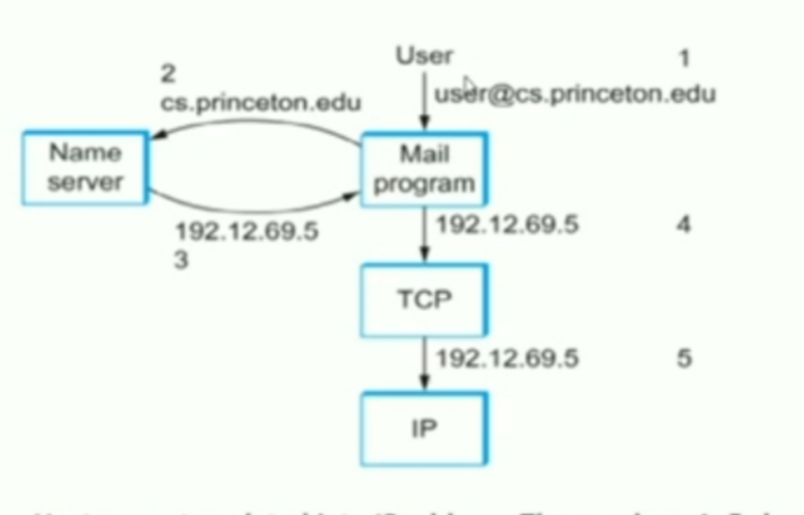
Host name translated to address

Slide 12
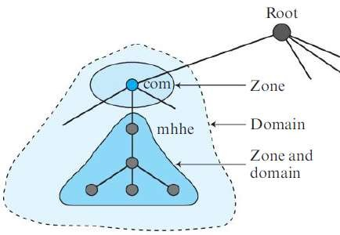
Distribution of name space
The information contained in the domain name space must be stored.
It is very inefficient and also unreliable to have just one computer to store such a huge amount of information.
It is inefficient because responding to requests from all over the world places a heavy load on the system.
It is not unreliable because any failure makes the data inaccessible.

Slide 13
HIERARCHY OF NAME SERVERS
The solution to the problems is to distribute the information among many computers called DNS servers.
One way to do this is to divide the whole space into many domains based on first level.
Let the root stand alone and create as many domains(subtrees) as there are first level nodes.
Because, a domain created in this way could be very large.
DNS allows domains to be divided further into smaller domains(subdomains).
Each server can responsible for either a large or a small domains.

Slide 14
ZONE
Since the complete domain name hierarchy cannot be stored on a single server, it is divided among many servers.
What a server is responsible for or has authority over is called zone.
Zone as a contiguous part of a entire tree.
If a server accepts responsibility for a domain and does not divide the domain into smaller domains, the domain and zone refer to the same thing.
The server makes database called a zone file and keeps all the information for every node under that domain.
The information about the nodes in the subdomains is stored in the servers at the lower levels, with the original server keeping some sort of reference to these lower-level servers.
the original server does not free itself from responsibility totally: It still has a zone, but the detailed information is kept by the lower-level servers.

Slide 15
Root Server
A root server is a server whose zone consists of the whole tree. A root server usually does not store any information about domains but delegates its authority to other servers, keeping references to those servers. There are several root servers, each covering the whole domain name space. The servers are distributed all around the world.
Primary and Secondary Servers
DNS defines two types of servers: primary and secondary. A primary server is a server that stores a file about the zone for which it is an authority. It is responsible for creating, maintaining, and updating the zone file. It stores the zone file on a local disk.
A secondary server is a server that transfers the complete information about a zone from another server (primary or secondary) and stores the file on its local disk. The secondary server neither creates nor updates the zone files. If updaJing is required, it must be done by the primary server, which sends the updated version to the secondary. The primary and secondary servers are both authoritative for the zones they serve. The idea is not to put the secondary server at a lower level of authority but to create redundancy for the data so that if one server fails, the other can continue serving clients. Note also that a server can be a primary server for a specific zone and a secondary server for another zone. Therefore, when we refer to a server as a primary or secondary server, we should be careful to which zone we refer.
A primary server loads all information from the disk file; the secondary server loads all information from the primary server. When the secondary downloads information from the primary, it is called zone transfer.

Slide 16
Dns in the internet
DNS is a protocol that can be used in different platforms. Due to the rapid growth of internet, it became extremely difficult to keep track of the inverse domains, which could be used to find name of host when given the IP address. In the Internet, the domain name space (tree) is divided into three different sections: generic domains, country domains, and the inverse domain.
Generic Domain
The generic domains define registered hosts according to their generic behavior. Each node in the tree defines a domain, which is an index to the domain name space database.
Country Domains
The country domains section uses two-character country abbreviations (e.g., us for United States). Second labels can be organizational, or they can be more specific, national designations. The United States, for example, uses state abbreviations as a subdivision of us (e.g., ca.us.)

Slide 17
Inverse Domain
The inverse domain is used to map an address to a name. This may happen, for example, when a server has received a request from a client to do a task. Although the server has a file that contains a list of authorized clients, only the IP address of the client (extracted from the received IP packet) is listed. The server asks its resolver to send a query to the DNS server to map an address to a name to determine if the client is on the authorized list. This type of query is called an inverse or pointer (PTR) query. To handle a pointer query, the inverse domain is added to the domain name space with the first-level node called arpa (for historical reasons). The second level is also one single node named in-addr (for inverse address). The rest of the domain defines IP addresses. The servers that handle the inverse domain are also hierarchical. This means the net id part of the address should be at a higher level than the sub net id part, and the sub net id part higher than the host id part. In this way, a server serving the whole site is at a higher level than the servers serving each subnet. This configuration makes the domain look inverted when compared to a generic or country domain. To follow the convention of reading the domain labels from the bottom to the top, an IF address such as 132.34.45.121 (a class B address with net id 132.34) is read as 121.45.34.132.in-addr. arpa

Slide 18
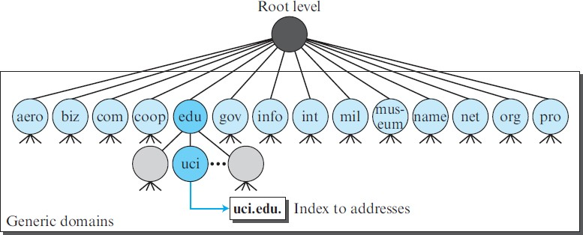

Slide 19
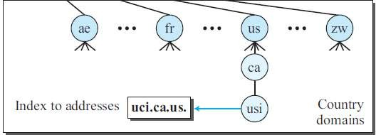

Slide 20
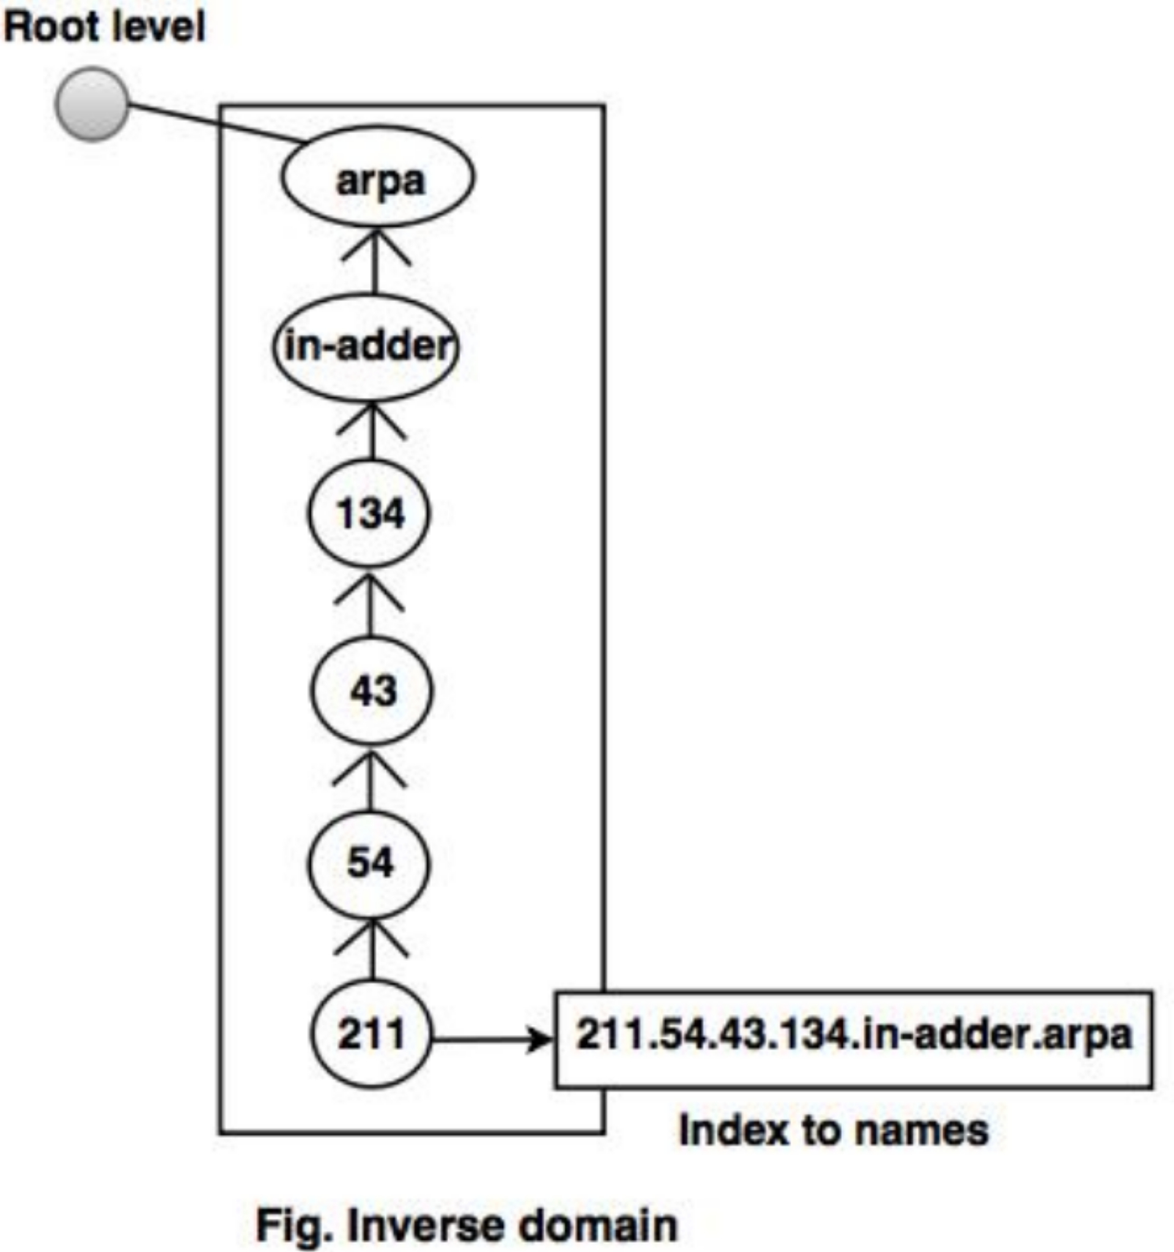

Slide 21
resolution
Mapping a name to an address is called Name-address Resolution
DNS is designed as a client-server application
A hosts that needs to map an address to a name or a name to an address calls a DNS client called a Resolver
The resolver accesses the closest DNS server with a mapping request
If server has information, it satisfies the resolver; otherwise, it either refers the resolver to other servers or asks other servers to provide the information
After the resolver receives the mapping, it interprets the response to see if it is a real resolution or an error and finally delivers the result to the process that requested it
Resolution is 2 types: Recursive and iterative resolution

Slide 22
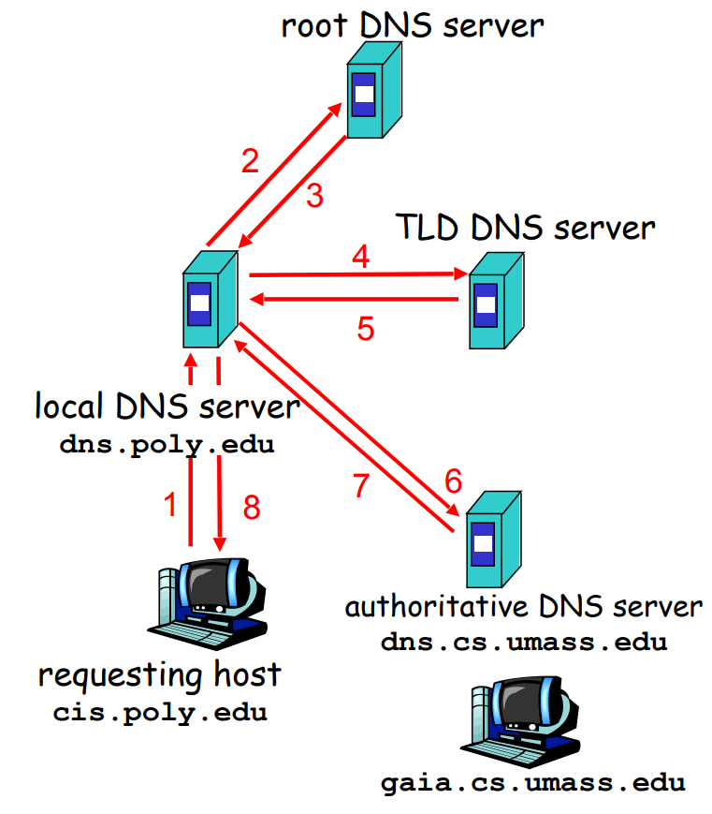

Slide 23
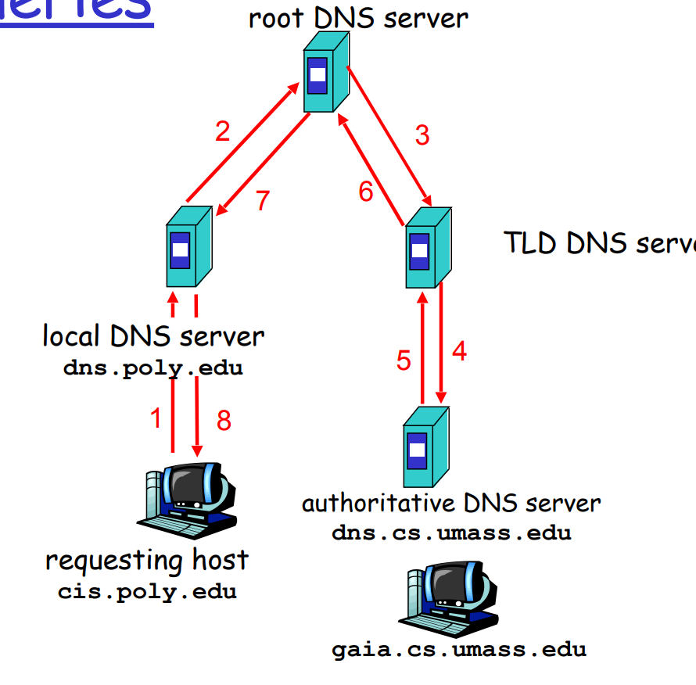

Slide 24
Iterative Query
contacted server replies with name of server to contact .
“I don’t know this name, but ask this server” .
Recursive Query
Puts burden of name resolution on contacted name
Heavy load

Slide 25
DNS Message
To retrieve information about hosts, DBS uses 2 type of messages :
Query and
Response
Both types have the same format
Query message is having 2 section : Header and Question records .
Response/reply message consists :
Header
Question
Records
Answer records
Authoritative records
Additional records

Slide 26
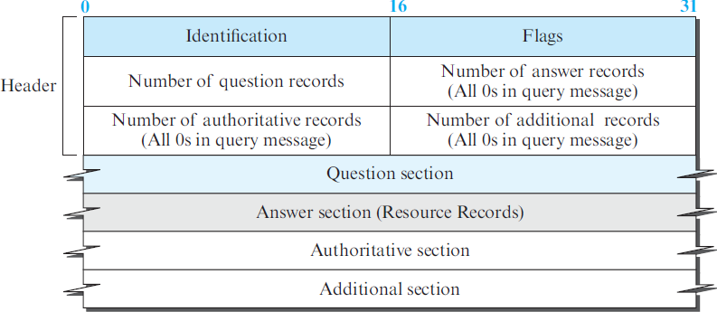

Slide 27
The identification field is used by the client to match the response with the query.
The flag field defines whether the message is a query or response. It also includes status of error.
The next four fields in the header define the number of each record type in the message.
The question section, which is included in the query and repeated in the response message, consists of one or more question records.
It is present in both query and response messages.
The answer section consist of one or more resource records. It is present only in response messages.
The authoritative section gives information (domain name) about one or more authoritative servers for the query.
The additional information section provides additional information that may help the resolver.

Slide 28
Types of records
DNS RESOURCE RECORDS := There are 12 records.
The zone information associated with a server is implemented as a set of resource records.
A name server stores a database of resource records.
RR is a 5 tuple structure.
(Domain Name, Type, Class, TTL, Value)
Domain name field is what identifies the RR.
The value defines the information kept about the domain name.
The TTL defines number of seconds for which the information is valid.
Type=A
name is hostname
Value is IP address.
Type=NS
Name is domain (foo.com)
Value is hostname of authoritative name server for this domain

Slide 29
Type=CNAME
Name is alias name for some “Canonical” (real) name
www.ibm.com is really
Servereast.backup2.ibm.com
Value is canonical name
Type=MX
Value is name of mailserver

Slide 30
ddns
Dynamic Domain Name System.
In DNS, when there is a change, such as adding a new host, removing a host, or changing an IP address, the change must be made to the DNS master file.
These types of changes involve a lot of manual updating.
The size of today’s Internet does not allow for this kind of manual operation.
The DNS master file must be updated dynamically.
The Dynamic Domain Name System (DDNS) therefore was devised.
In DDNS, when a binding between a name and an address is determined, the information is sent, usually by DHCP (Dynamic Host Configuration Protocol )to a primary DNS server.
The primary server updates the zone.
To provide security and prevent unauthorized changes in the DNS records, DDNS can use an authentication mechanism.

Slide 31
Conclusions
APPLICATION LAYER
To allow access to network resources.
Application layer is also called Software Layer / Upper Layer.
It enables the user, whether human or software, to access the network.
It provides user interfaces/ support for services such as email.
It is responsible for providing services to the user
E.g.:) mail, file transfer, remote login etc.
Protocols are: HTTP, SMTP, FTP, TELNET, SSH, SNMP, DNS, IGMP, POP3.
So, DNS is the protocol f application layer.
DNS is the naming service.
DNS is phonebook of internet.

Slide 32


